Slide 1
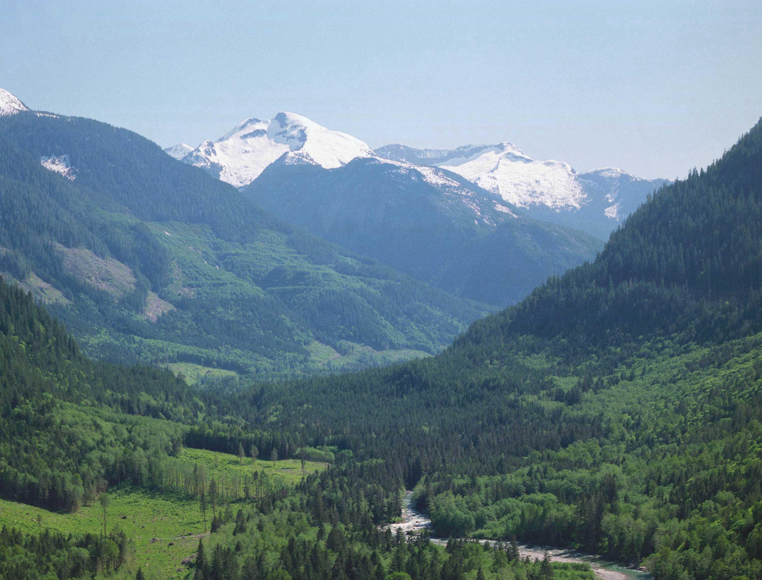

Monitoring Visual Quality Objectives
under Forest & Range Evaluation Program (FREP)
North Island Central Coast
Forest Management Leadership Team
April 15, 2015
Presented by:
Lloyd Davies, RPF
Visual Resource Management Specialist
Coast Forest Area (Nanaimo)
Ministry of Forests, Lands & Natural Resource Operations

Slide 2
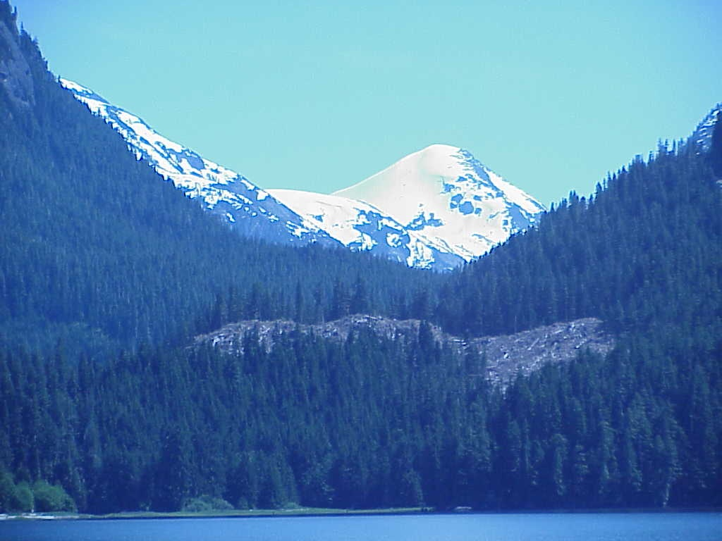
Objectives:
Overview of FREP Visual Quality Effectiveness Evaluation procedures
Review of NICC FREP results for VQOs (Andy Waines)
Provincial VQO monitoring trends: FPC vs FRPA (field day)

Slide 3
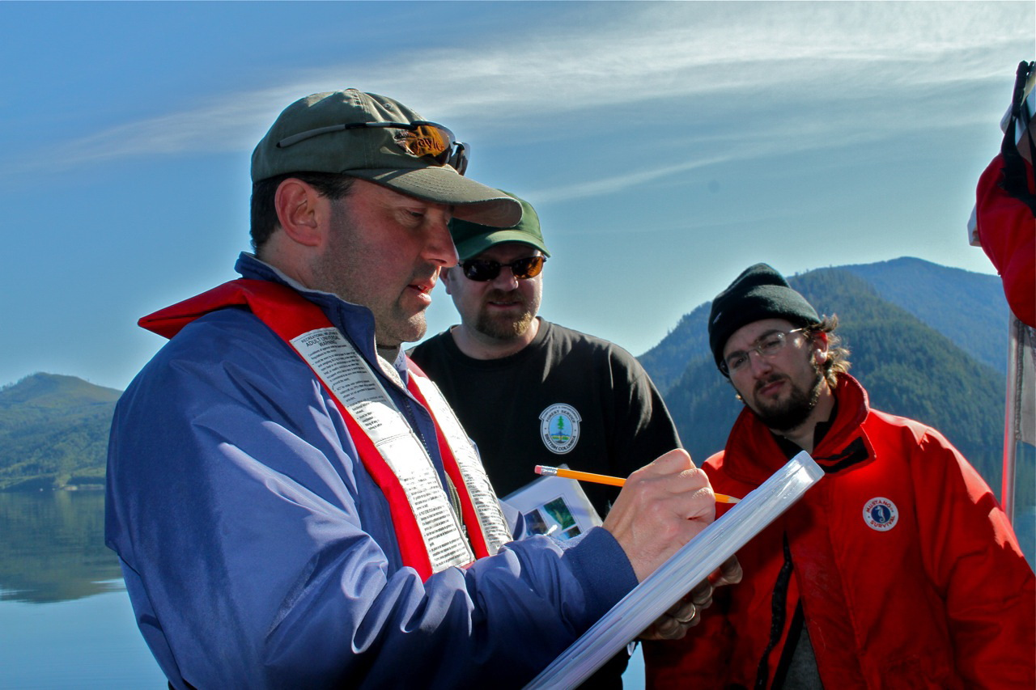
Crash Course in Forest & Range Evaluation Program (FREP)
Visual Quality Effectiveness Evaluation

Slide 4
How do we Manage for Visual Quality in BC?
Conduct research to determine Public Preferences.
Carryout Visual Landscape Inventory to identify the visible landscape and rate its sensitivity to human made alteration.
Designate important visible landscapes as Scenic Areas
Establish Visual Quality Objectives to define the level of alteration that would be acceptable on the landscape.
Approve Results/Strategies in FSP’s that will be consistent with established VQOs.
Conduct C&E inspections, to ensure that the results specified are achieved, or the strategies have been carried out.
Carry out FREP Visual Quality Objective Effectiveness Evaluations to monitor trends in visual quality management.

Slide 5
Visual Quality Effectiveness Evaluation
What is it?
It is a process and set of criteria used to determine whether established visual quality objectives (VQO’s) are being achieved….. adding rigour.
Role:
Its role is to provide information on resource status/trends, which in turn will identify if forest legislation, policies and practices are working.
NICC:
NICC stewardship staff have been monitoring the visual quality of forest harvesting in scenic areas since 2008. (65 samples)

Slide 6
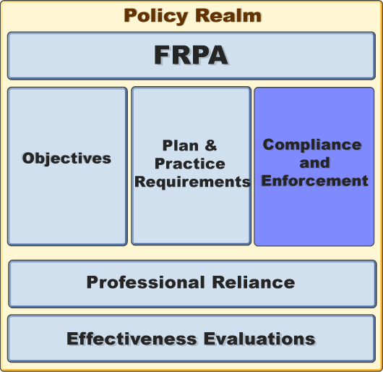
FREP Monitoring- Effectiveness Evaluations
One of the foundations of the FRPA functional architecture is stewardship monitoring… VQOs.
FSPs
VQOs
R/S

Slide 7

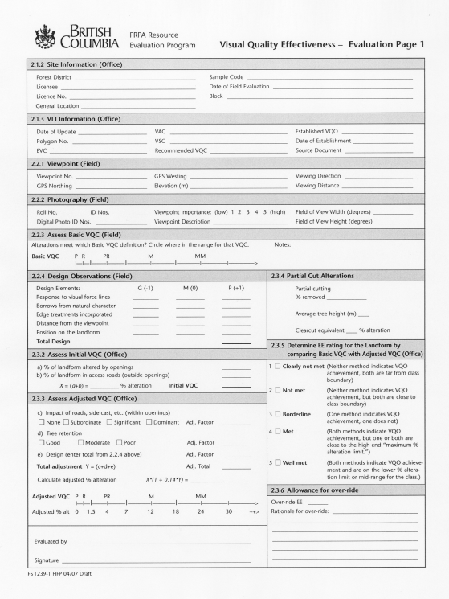
Visual Effectiveness Evaluation
Draft procedures & standards document released July 2004 and revised in 2005. Finalized in 2008.
The procedures & standards were developed to be applied to a single block or multiple blocks visible from given viewpoints suitable for Resource Stewardship Monitoring or may be used more broadly at a regional or provincial level.

Slide 8
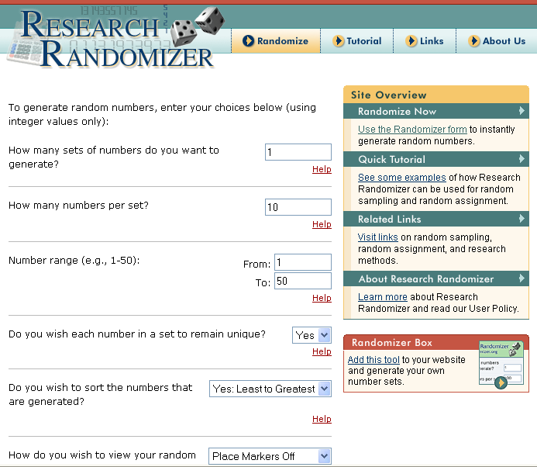
Choosing Evaluation Samples
Regardless of how many openings a district has on their list,
all samples are to be chosen randomly.
The best way to do this is to put the list through a randomizer.
http://www.randomizer.org/form.htm

Slide 9
Choosing Viewpoints for Evaluations
Examples of viewpoints that might be considered when
doing an evaluation:
a stretch of highway leading toward a harvest unit,
a rest stop,
a recreation site or park,
a group of homes, or settlement, or
a tourist-related commercial enterprise.
It is important to review the location(s) offering
the best or most direct view of the alteration. This may not
necessarily be a viewpoint that provides a stationary or
stopping location.
Warning: Visual Landscape Inventory viewpoints were used to derive visual sensitivity unit boundaries and for rating the sensitivity of the landscape.
They were not derived for use to assess VQO compliance.

Slide 10


Significant Public Viewpoint
FPPR (proposed definition)
A significant public viewpoint:
a place or location on the land or water that is accessible to the public,
provides a viewing opportunity and has relevance to the landform
being assessed.

Slide 11
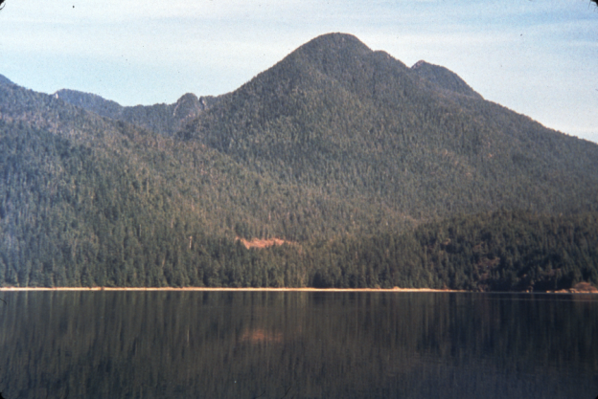
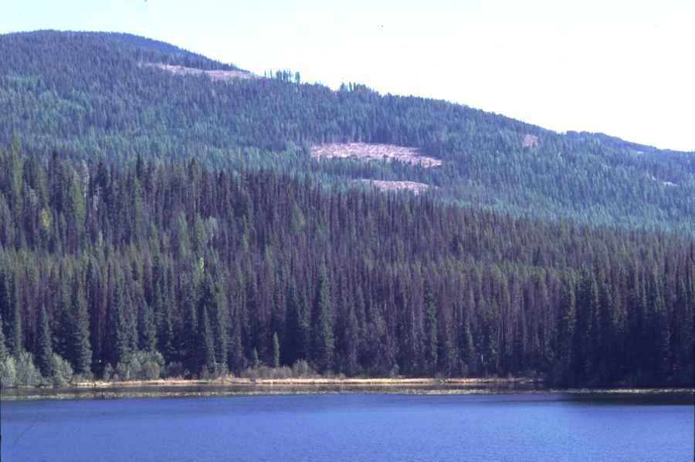
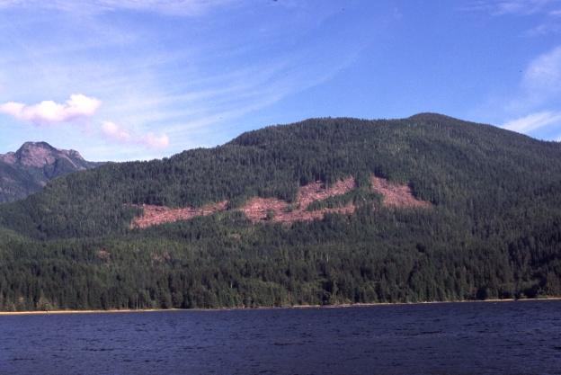
Visual Quality Objectives
VQOs are management objectives established by the District Manager under the Government Action Regulation Sect 7(2). They are used to reflect society’s desired level of visual quality on the landscape.
The Forest Planning and Practices Regulation S.1.1 defines 5 categories of alteration:
Preservation, Retention, Partial Retention, Modification & Maximum Modification.
Retention
Partial Retention
Modification

Slide 12
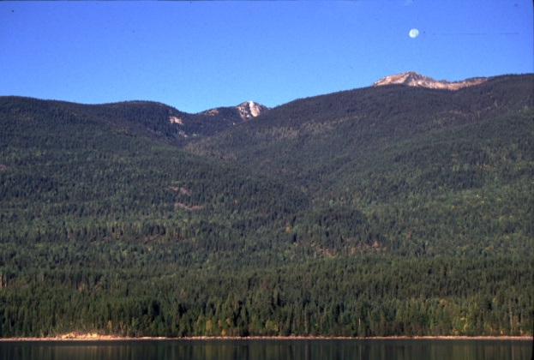
Visual Quality Objectives
Preservation:
Alteration, when assessed from a significant public viewpoint, is:
very small in scale, and
not easily distinguishable from the pre-harvest landscape.
Predicted by 0% alteration of landform.

Slide 13
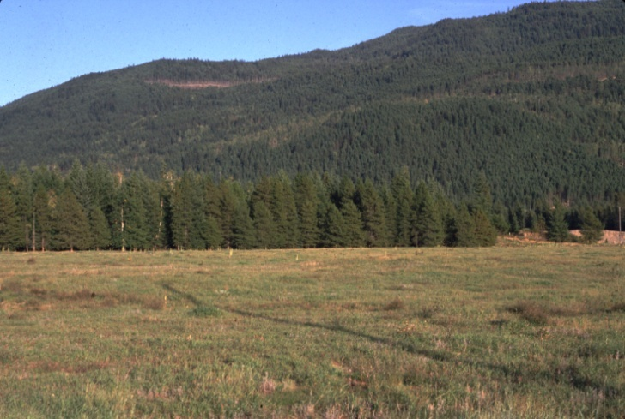

Visual Quality Objectives
Retention:
Alteration, when assessed from a significant public viewpoint, is:
(i) difficult to see,
(ii) small in scale, and
(iii) natural in appearance.
0.3%
Predicted by 0 - 1.5% alteration (clearcutting) of the perspective landform
0.9%

Slide 14
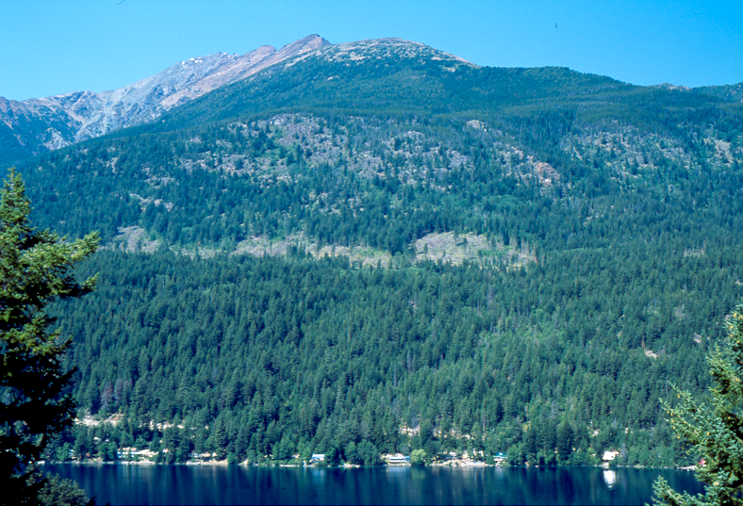
Visual Quality Objectives
Partial Retention:
Alteration, when assessed from a significant public viewpoint, is
(i) easy to see,
(ii) small to medium in scale, and
(iii) natural and not rectilinear or
geometric in shape.
3.1%
Predicted by 1.6 - 7.0% alteration
of landform in perspective.
5.3%

Slide 15

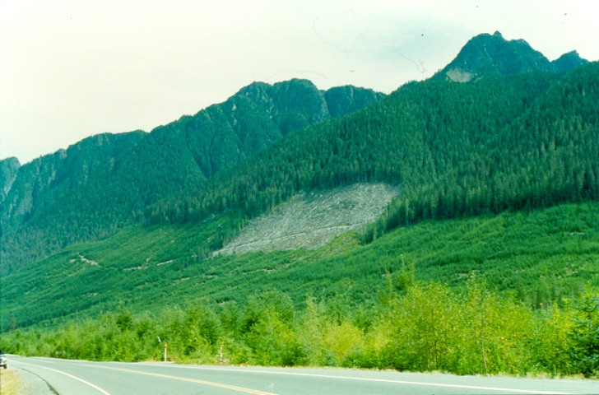
Visual Quality Objectives
Modification:
Alteration, when assessed from a significant public viewpoint, is
is very easy to see, and
is (A) large in scale and natural in its appearance, or (B) small to medium in scale but with some angular characteristics.
5.9%
7.3%
Predicted by 7.1 – 18.0% alteration

Slide 16
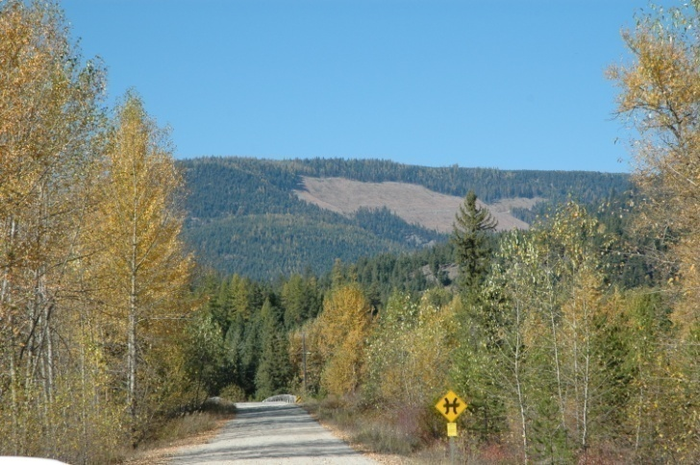
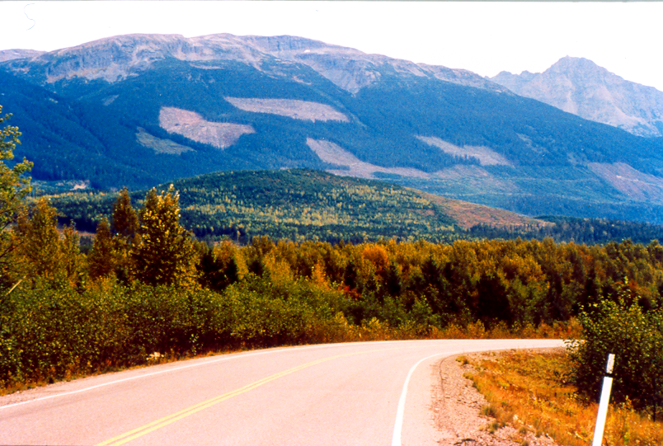
Visual Quality Objectives
Maximum Modification:
Alteration, when assessed from a significant public viewpoint, is
very easy to see, and (ii) is
(A) very large in scale,
(B) rectilinear and geometric in shape, or
(C) both.
19.0%
11.8%
Predicted by 18.1 – 30.0 % alteration

Slide 17
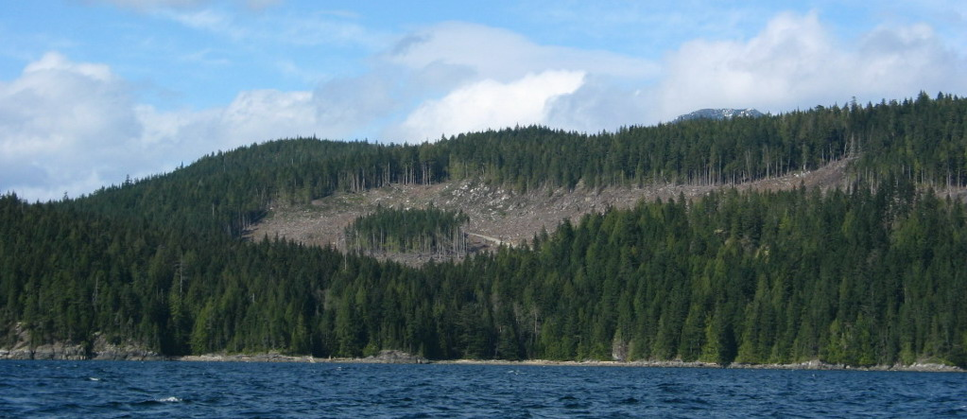
VQO Effectiveness Evaluation Procedures
The effectiveness evaluation monitors conformance with the VQO from selected viewpoints using two independent measures:
each category of alteration (VQO) is evaluated using an ocular “eye” assessment and compared to the legal definition; (in field)
the perspective percent landform alteration and design elements are assessed using standards and criteria derived through research. (office measurements)
Priority should always be given to meeting legal definition. (FRPA s. 1.1)

Slide 18
VQO / VQC % Perspective % Plan TSR analysis
Preservation 0 0 – 1
Retention 0 – 1.5 1.1 – 5
Partial Retention 1.6 – 7.0 5.1 – 15
Modification 7.1 – 18.0 15.1 – 25
Maximum Modification 18.1 – 30.0 25.1 – 40
Note: ranges apply to total “green” area of landform unit, middleground, and for clear cutting only. Outside these parameters, scale of alteration becomes an unreliable predictor of VQO.

Slide 19
FREP Evaluation vs C&E Inspection
FREP
Multiple samples necessary.
Openings chosen randomly.
Evaluates trends over time.
Reporting looks at actions needed to improve practices i.e. training.
Evaluation procedure similar to Inspection.
Numerical assessment has equal weight to ocular assessment.
FREP Evaluations could alert C&E to potential issues.
C&E Inspection
Generally a single sample.
Openings are targeted.
Evaluates compliance with VQO.
Reporting out may lead to an investigation and penalties.
Inspection procedure similar to evaluation.
Numerical assessment supports ocular assessment.
Inspections could potentially augment FREP sampling.

Slide 20
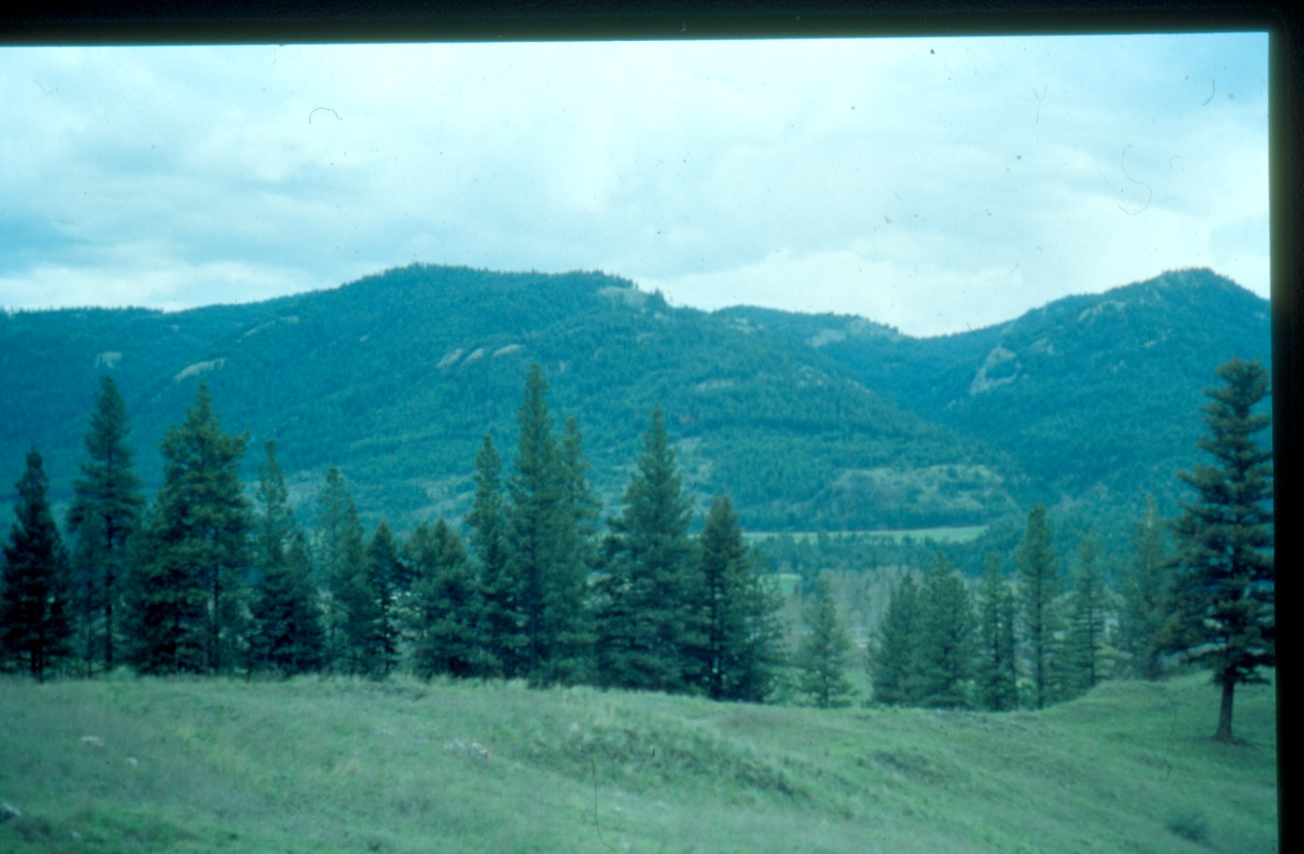
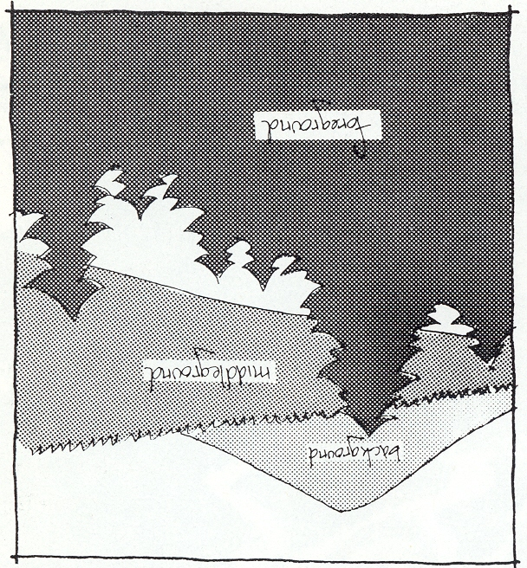
Understanding the Landscape
The existing MFR Visual Program was developed to address alterations on the mid-ground & background landscapes.
More than 8 Km
Background
Midground
1- 8 Km from viewer
Foreground
0-1 Km from viewer
MFLNRO has recently conducted research into the management of foreground views.

Slide 21
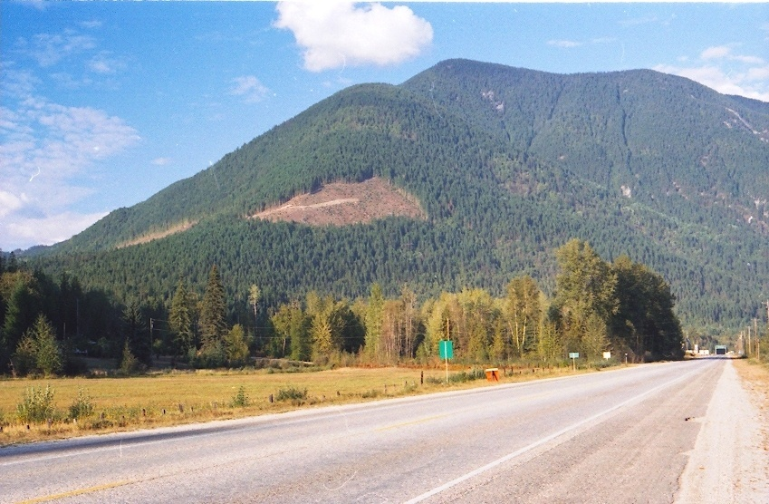
We manage alterations on landforms as opposed to the total scene.
Background Not Included
Landform outlined in yellow
Foreground Not included
Landform: a distinct topographic feature that is three dimensional in form and is generally
defined by ridges, valleys, shorelines and skylines. Examples include hills and mountains.
80% of the time landforms are reasonably easy to define.

Slide 22
Measuring % Alteration
Completed on photographs
Digital planimeter, or
Adobe Acrobat Standard 9
ARC GIS
B
A
C
Area
B + C
% Alteration
Total Green Landforms
X
100
=
Area
A
33

Slide 23

Completing the
Effectiveness Evaluation Form
We will now work through the various components of the EE form.
The coloured sections will be more fully explained as we progress through this slide show.
There are two streams one for clear cuts and one for partial cuts. Section 2.3.4 deals with partial cuts and won’t be discussed.

Slide 24

Completing the Header
Columbia
DCO-006
Bell Pole
July 27, 2007
A18992
CP 18 BLK C01006
Dupont Creek
Step 1: Fill in the administration info (District, licensee, Blk coding, etc.) in the office.
The Sample Code is a tracking identifier that facilitates coordination between field sheets, photography, and subsequent databases. For this project the District initials followed by a sample number starting at 001 should suffice.
Note: One form is to be completed from each viewpoint selected for evaluation. In some cases a block may be evaluated from multiple viewpoints.

Slide 25
Record Visual Landscape Inventory and VQO Information
June 2003
M
M
2449
3
2000
MM
N/A
DM Letter
Step 2: Fill in VLI inventory and VQO information.
Confirm the established VQO and date of establishment by checking source documents.

Slide 26
Record Viewpoint & Take Photos
1
117º 59’ 26.7
56º
50º 41’ 58.7
518 M
5 KM
26º
NKN_024-027
Unofficial Stop
10º
Step 3:
Choose Viewpoint and take Photographs:
It is important to choose viewpoints that provide a good view of the block being assessed. These may be viewpoints that were used by the licensee in their Visual Impact Assessment, viewpoints identified in the VLI or may be completely new locations.
Record the photography information.

Slide 27
Assess Basic VQO Definition (field)
Step 4:
Using the written definitions of visual quality classes in Table 1 of the EE form, compare their descriptions to the alteration present on the landscape …
Make an ocular “eye” evaluation. VQO Poster may be helpful.
Determine which category of alteration (achieved VQO) is the best fit and identify the class on the bar graph. You may wish to refine your initial determination by identifying whether the determination is toward the low, mid or upper range for the class.
Optional “Notes” on viewing context, duration, etc.

Slide 28
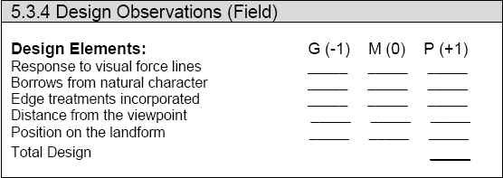
5.3.4 Assess Visual Design (field)
0
+1
+1
-1
+1
+2
Step 5:
Determine the influence of visual design, by answering the following questions with a Good, Moderate or Poor response.
1. Does the alteration respond to the major lines of force?
2. Does the alteration borrow from the natural character of
the landscape?
3. Have edge treatments been incorporated?
4. How far is the alteration from the viewpoint?
5. What position does the alteration occupy on the landform?

Slide 29
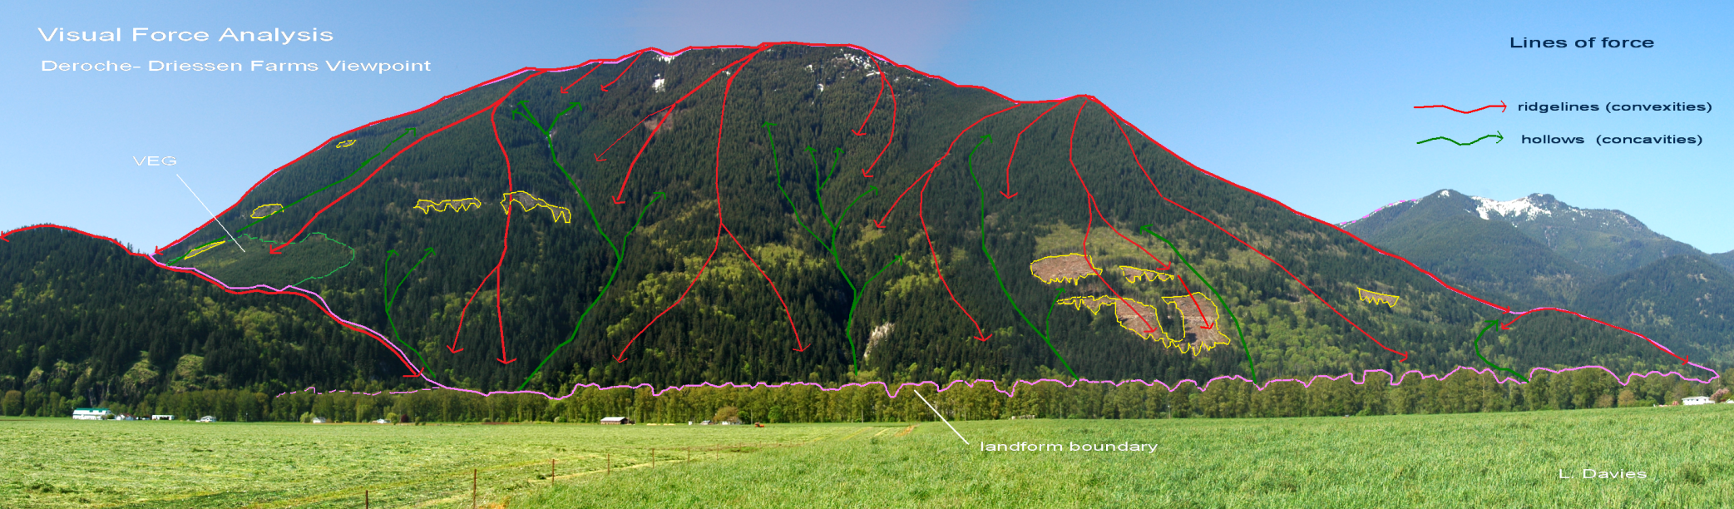
Example of completed visual force analysis
Determining the degree to which forest harvesting & road building reflects/responds to the major lines of visual force is a key indicator of design quality.

Slide 30
Assessing Scale of Perspective landform (office)
11.7
0
11.7
M
Step 6:
The Initial VQC rating is assessed by measuring the scale of alteration on the landform and comparing the result with the percent alteration ranges in Table 2 below.
Visual Quality Class | Alteration % of landform in perspective view
P - Preservation | 0
R - Retention | 0 – 1.5
PR - Partial Retention | 1.6 – 7.0
M - Modification | 7.1 – 18.0
MM - Maximum Modification | 18.1 – 30.0

Slide 31
Adjusting Initial VQC scale of alteration (office)
X
+1
X
0
+2
+3
16.6
Step 7: Adjust Initial VQC
The initial % alteration figure (derived earlier from the photographs) is adjusted upward or downward, depending on the degree of positive or negative visual influences. Three aspects of the visual scene (site disturbance, tree retention & design) are assessed on a qualitative scale.

Slide 32
Determining the final EE rating for the landform
Step 8:
Compare Basic VQC definition with the percent alteration.
The two evaluation methods may or may not match.
FRPA Definition remains the legal requirement.
x

Slide 33
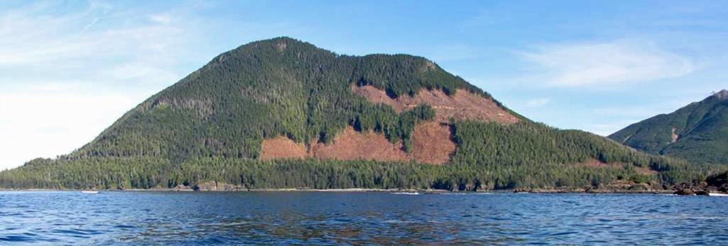
Example of FREP VQO Effectiveness Evaluation
Side Bay,
West Coast Vancouver Island
Photo by P. Barolet
Established VQO is Partial Retention

Slide 34
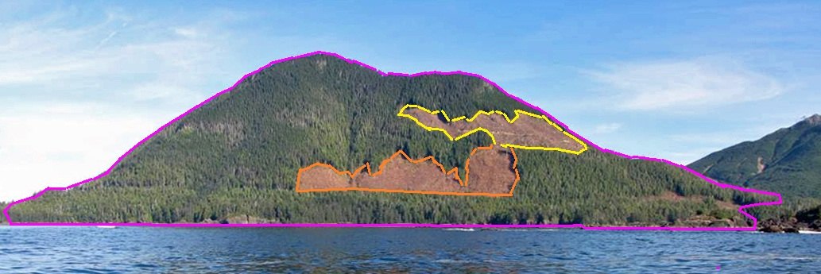
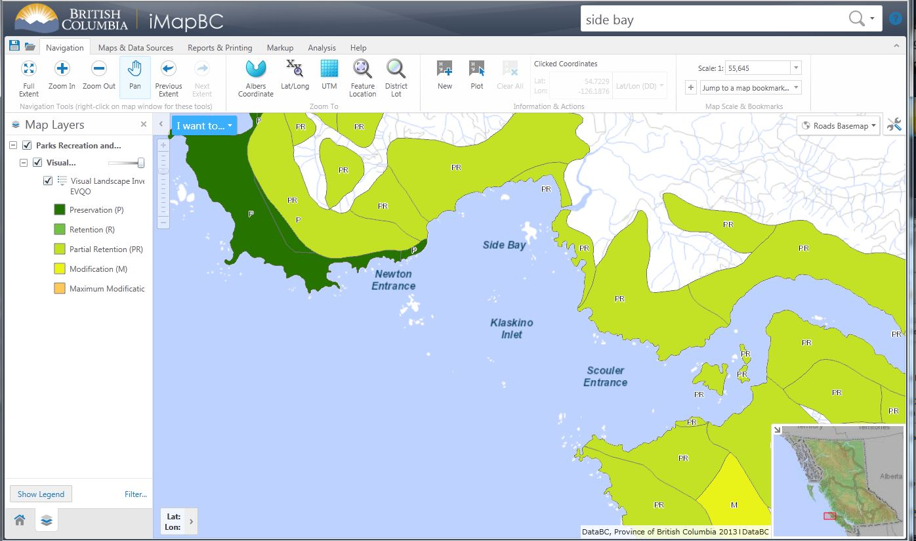
Delineating the topographical landform unit

Slide 35
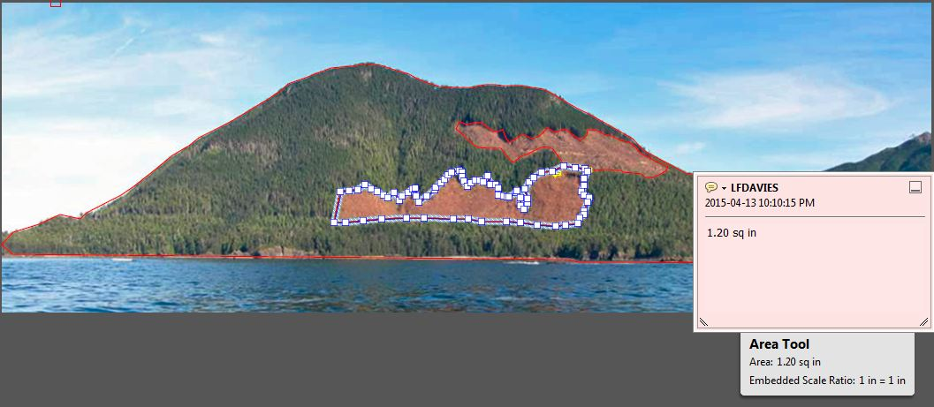
Calculating scale of perspective landform alteration
Landform = 13.48 units
Top block = 0.65 units (4.82%)
Bottom block = 1.20 units (8.90%)
______________
Total 1.85 units (13.72 %)
Predicts Modification VQO

Slide 36
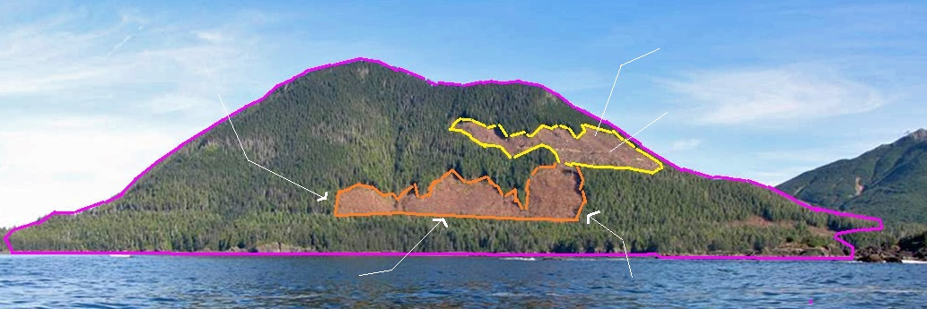
Visual Design Critique
High contrast in colour, texture, & shape
Focal positon
Angular corner
Subordinate roads
Straight unnatural lower boundary
Angular corner
Limited response to visual force lines
High contrast in colour, texture, and shape
Focal position
Lack of tree retention, minimal edge transition
Angular corners, and straight lower boundary

Slide 37
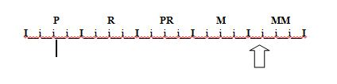
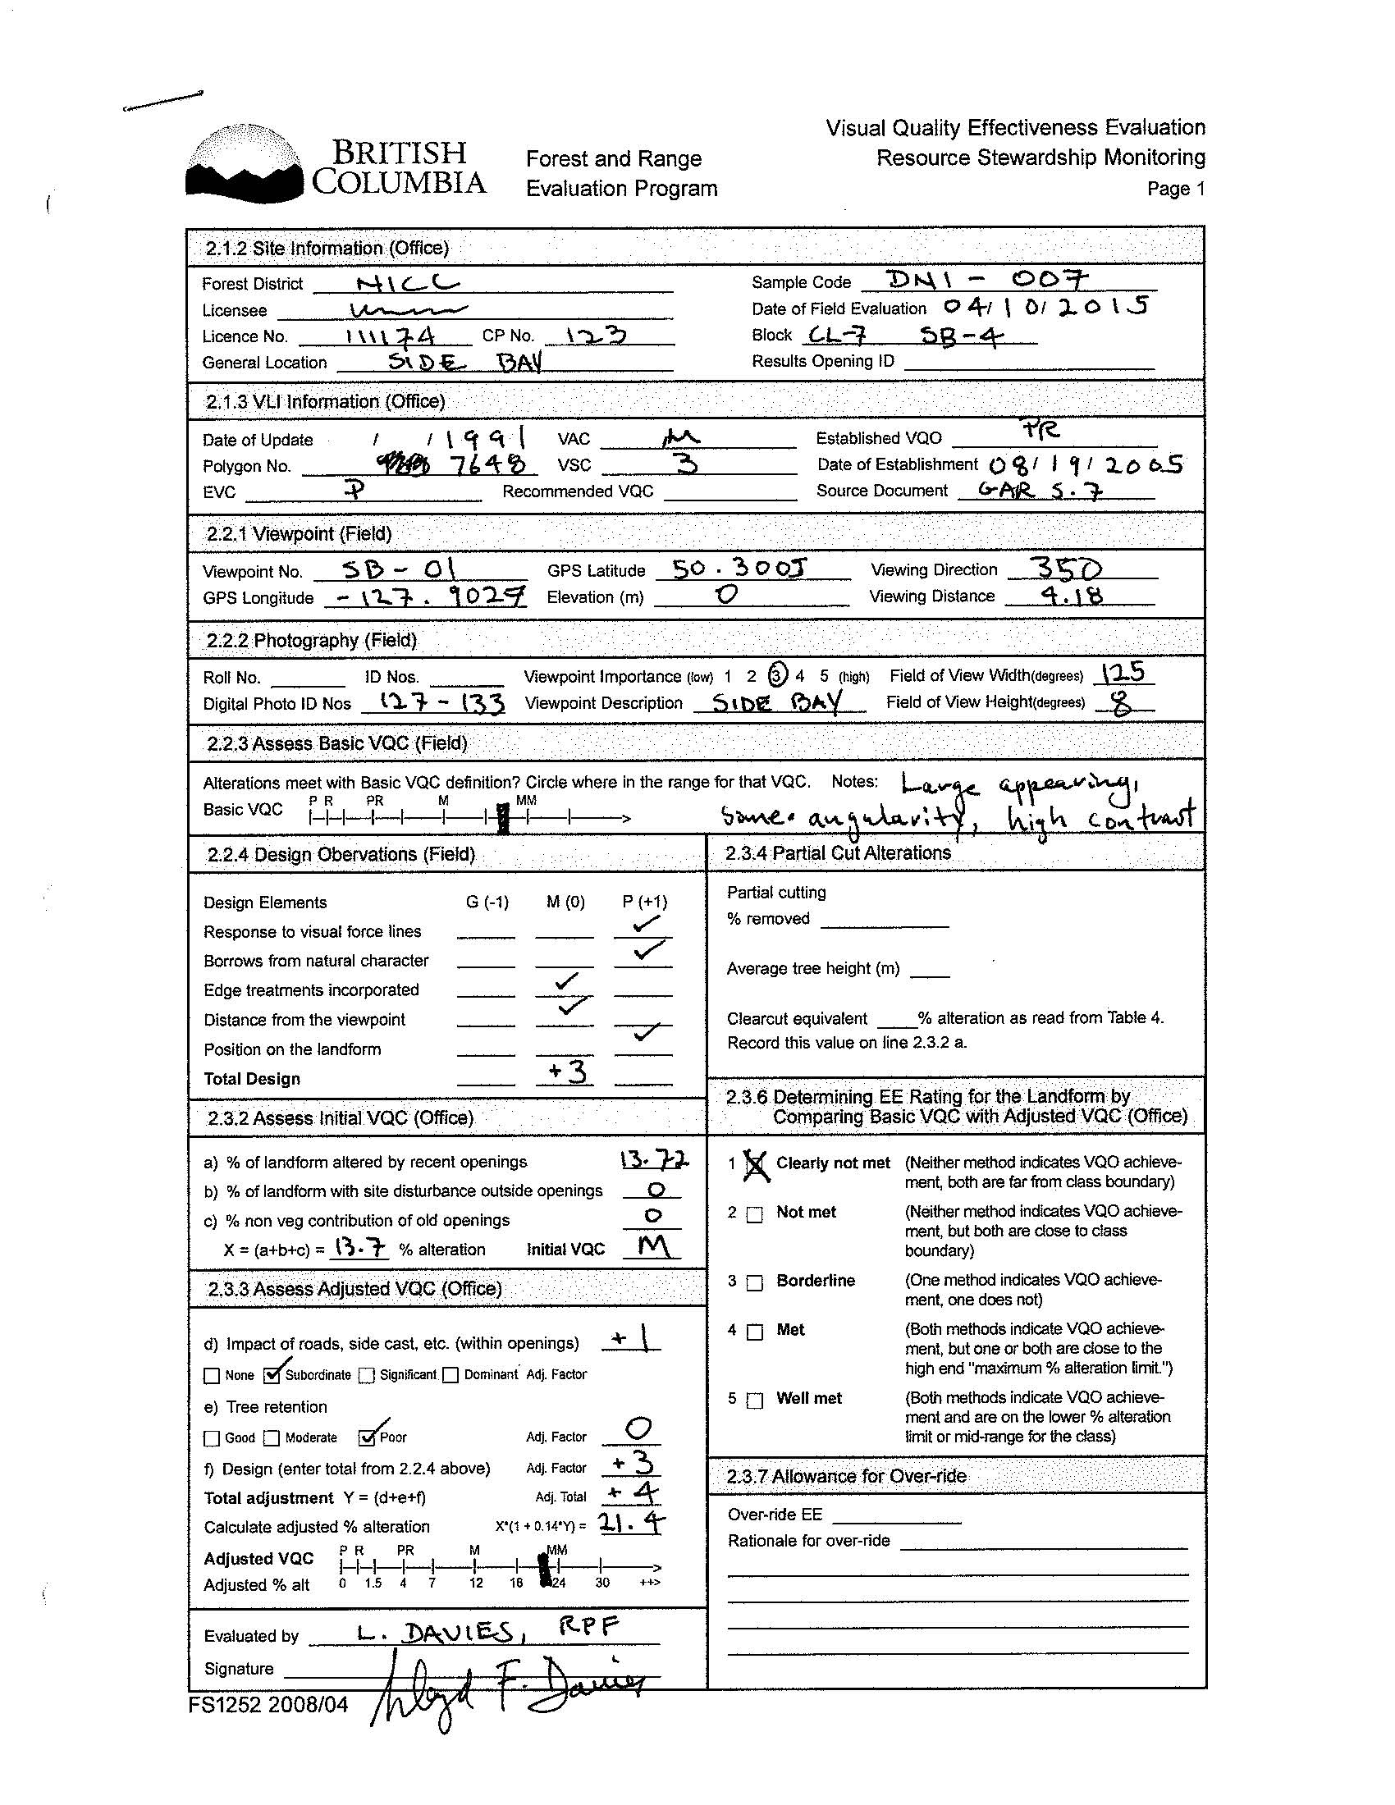
Ocular evaluation of basic definition …… MM
Response of visual force lines: poor +1
Borrowing natural characteristics: poor +1
Edge treatments: med 0
Distance from viewpoint: med 0
Position on landform: poor +1
Total design: +3
Impact of roads (subordinate) +1
Tree retention (poor) 0
Design total (from above) +3
Total adjustment (Y) +4
X * (1 + 0.14 Y) = adjusted % alteration
13.72 * (1 + (0.14 * 4)) = 21.40 % Max Modification
(clearly not met)
VQO EE form

Slide 38
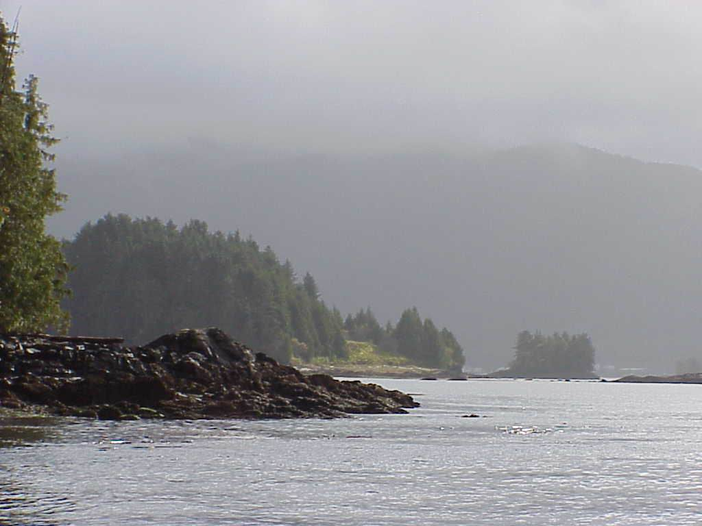
References and further reading:
Visual Landscape Design Training Manual, MOF, 1994
A First Look at Visually Effective Green-up in BC, MOF, 1994
Clearcutting and Visual Quality, A Public Perception Study, MOF, 1996
Visual Impacts of Partial Cutting, Summary Report, MOF, August 1997
Visual Impact Assessment Guidebook, MOF, January 2001
FREP Extension Note 13
FREP Extension Note 32
VRM Website: http://www.for.gov.bc.ca/hfp/fordev/visual_resource_mgnt.htm

Slide 39
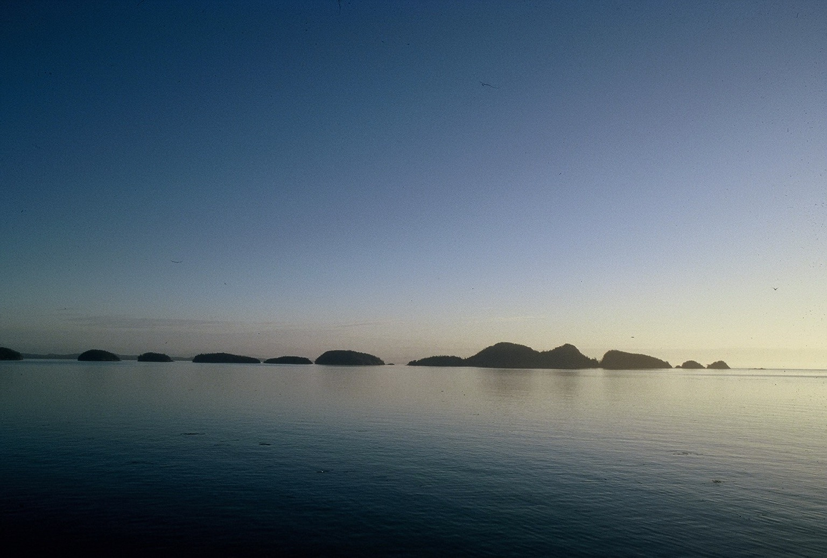
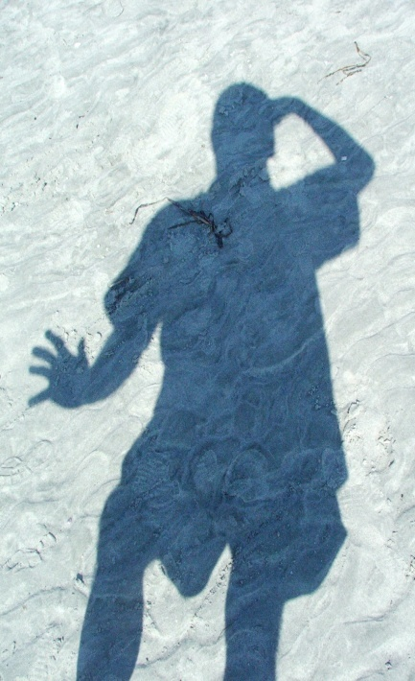
Lloyd Davies, RPF
Visual Resource Management Specialist
Ph. 250-751-7112
email: Lloyd.Davies@.gov.bc.ca
- the end –

Slide 40
NICC FREP VQO EE results have been excellent.
Well above the provincial average.
However, there are a few poor examples of VQO conformance discovered outside of FREP random sampling:
Quatsino Sound, West Coast, Vancouver Island
Side Bay, West Coast Vancouver Island
Tribune Channel, E of Gilford Island
Woss, Highway 19

Slide 41
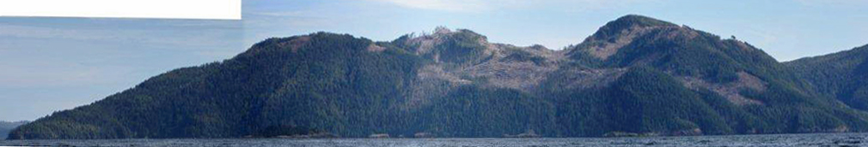
Quatsino Sound
Established VQO = Partial Retention
Resulting visual condition = Modifcation

Slide 42
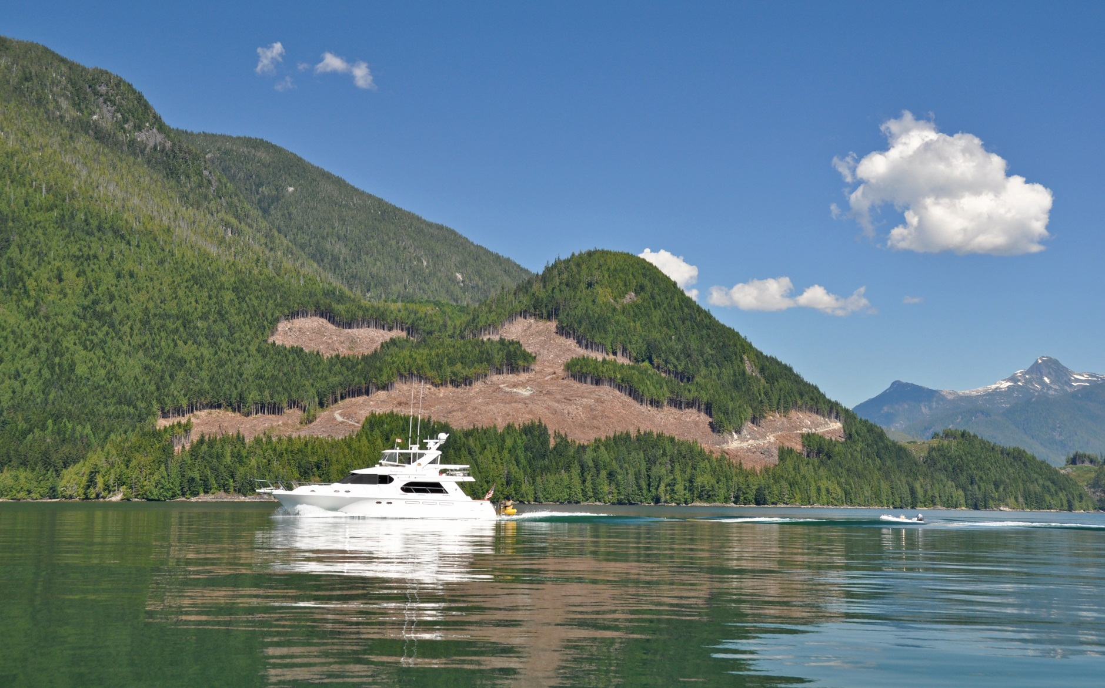
Tribune Channel
east of Gilford Island
Established VQO = PR Resulting VQC = M - MM

Slide 43
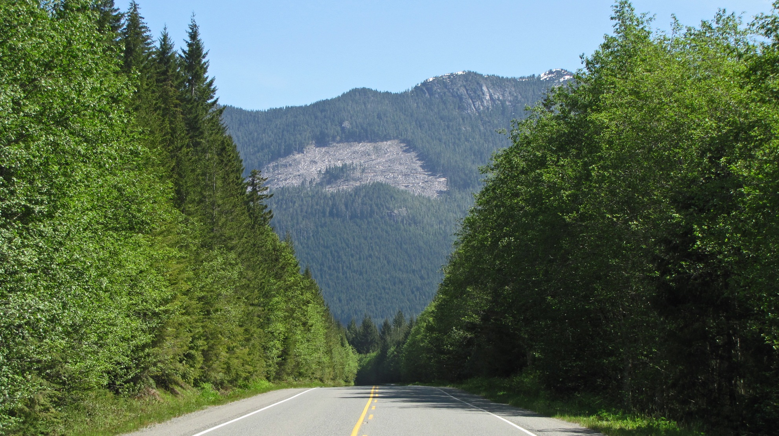
Highway 19 near Woss, BC
Established VQO = PR Resulting VQC = Modification

Slide 45
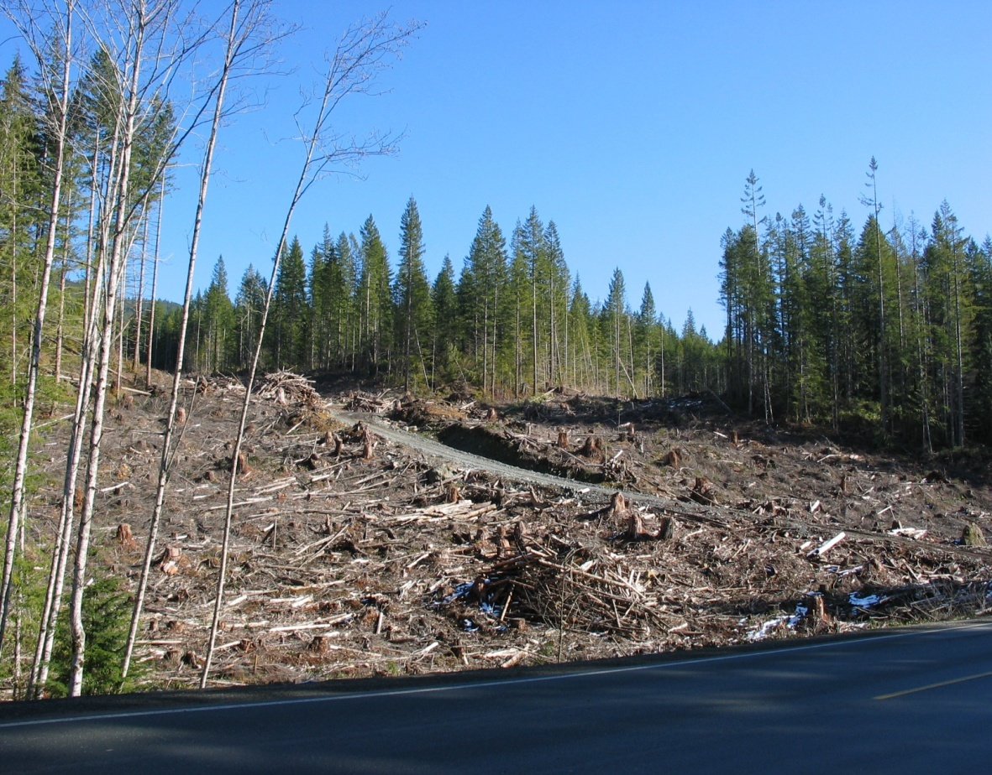
Highway Foreground Visual Management
Tidy, clean & green
Slash location & disposal
Hydro seeding
Interpretative Signage
May 2005 Forest Practices Board audit of VRM in Campbell River Forest District highly critical of roadside harvesting.
Highway 19 Campbell River Forest District

Slide 46
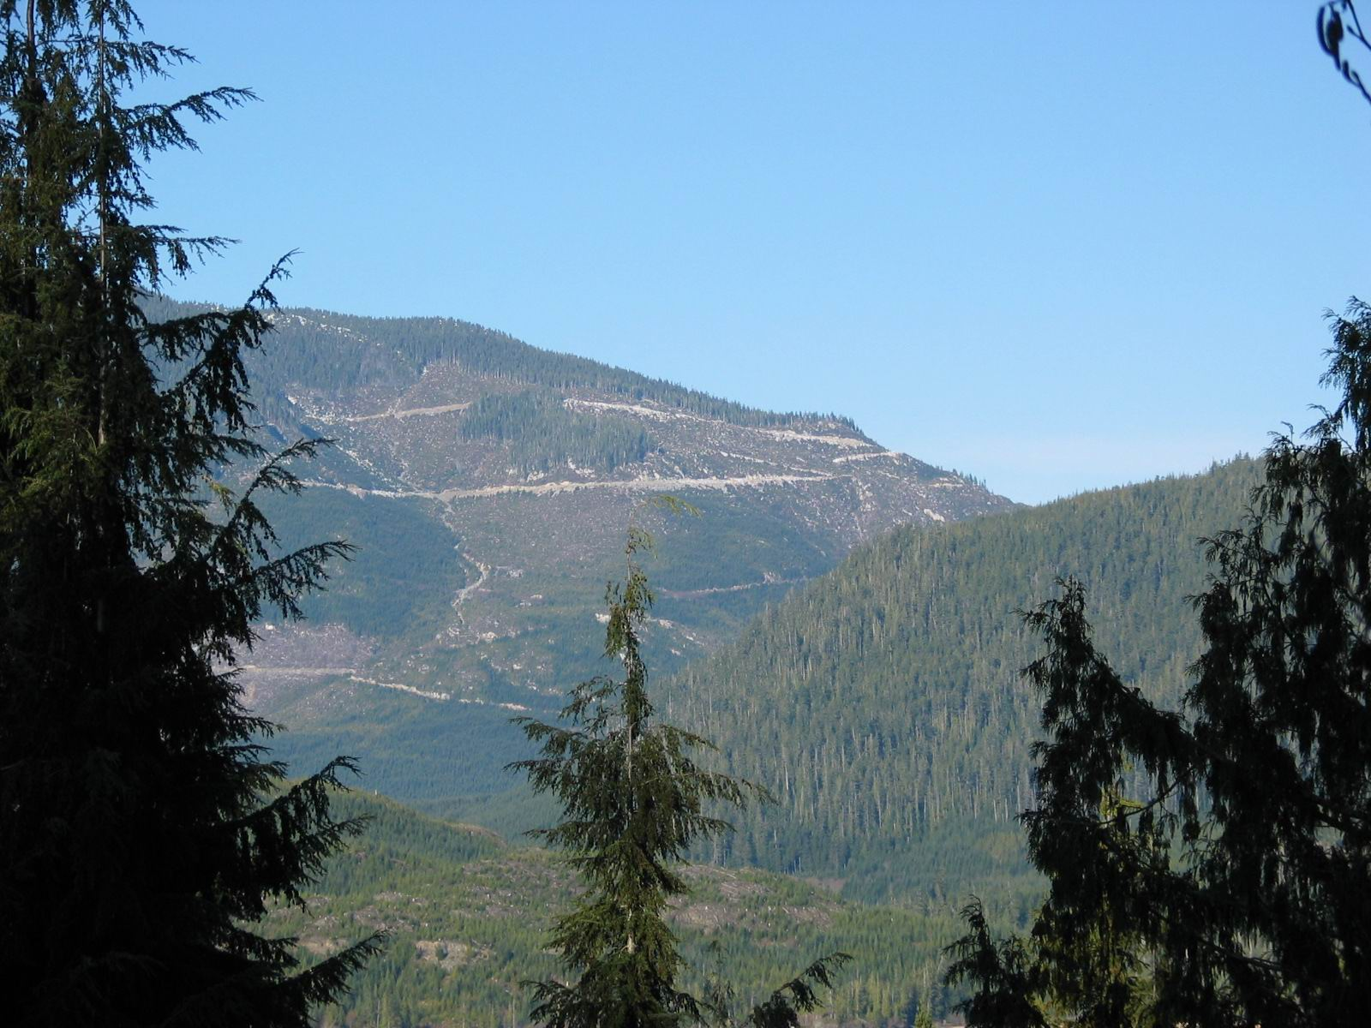
Visual Impact of Roads
long lasting visual impacts of roads
Nimpkish Lake, TFL 37

Slide 47
Visual Landscape Design Training Manual, MOF, 1994
1 - 2 day training course:
Visual Landscape Design Concepts and Principles
Landscape Character Analysis … lines of force
Visual Landscape Design Applications
Design Techniques
Integrated Visual Design Process
Hands-on practice

Slide 48
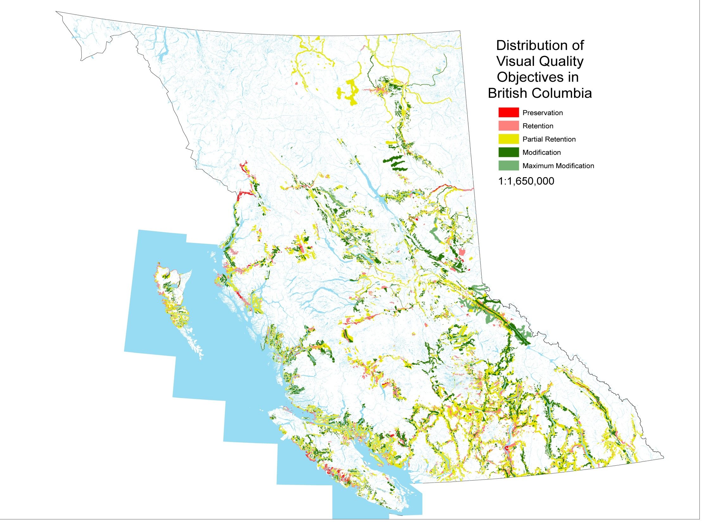
109,746 Ha.
1,326,945 Ha
5,395,445 ha
3,177,422 ha.
461,301 ha
VQOs established on 10.5 million hectares of gross provincial land base. 72% of inventoried area has a VQO.

Slide 49
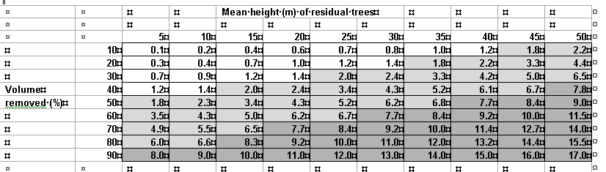
Procedures for Partial Cuts
Partial cuts are assessed for their Basic VQC in section 2.2.3 using the written definitions.
The Adjusted VQC is determined using a two-step “visual equivalent to clear cut” procedure. First you determine visual percent volume removed, by consulting SP or an ocular assessment. Once you have this go to the table below and determine the “visual equivalent to clear-cut” alteration number and plug this into section 2.3.4.
59

